Slide 1

Exploratory Data Analysis – Olympics 2021
Track 3
Team Algorithm Avengers:
@EmilyGoldfinch
@Slavensky73
@Logical

Slide 2
Hypothesis
Analyzing the 2021 Tokyo Olympics dataset can help predict the potential winners of the 2024 Paris Olympics!

Slide 3
Data Collection and Preprocessing
We used the dataset provided in project description and did our own research for more data.
We found a comprehensive dataset with statistics from the beginning of olympics.
These datasets were cleaned, normalized, and prepared for analysis using Python and Excel.

Slide 4
Tools Used
01
02
03
Kaggle
Python
To find a dataset
To clean the data and make a predictive model
04
Tableau
Excel
To visualize the data
To clean the data

Slide 5
Methodology
Cleaned Data
Exploratory analysis using Tableau
Predictive Analysis – Random Forest Classifier
Function that predicts 2024 results

Slide 6
Exploratory Analysis
We used Tableau to perform some exploratory analysis on the data and visualization.

Slide 7
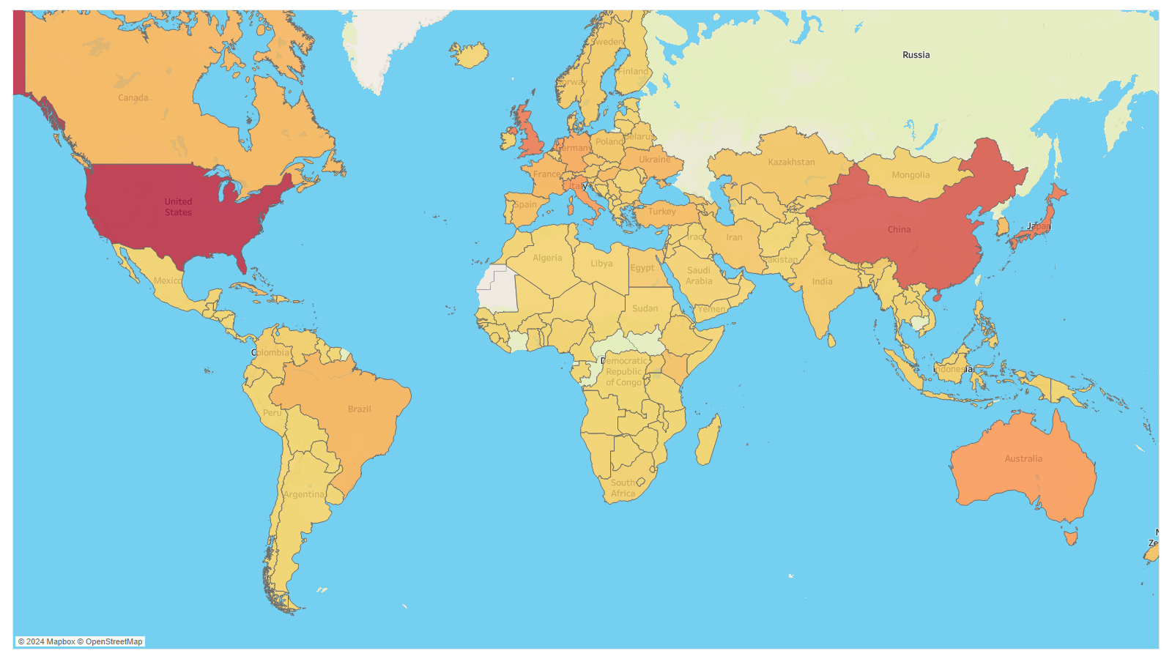
Geo Map Model of Medal Distribution 2021

Slide 8
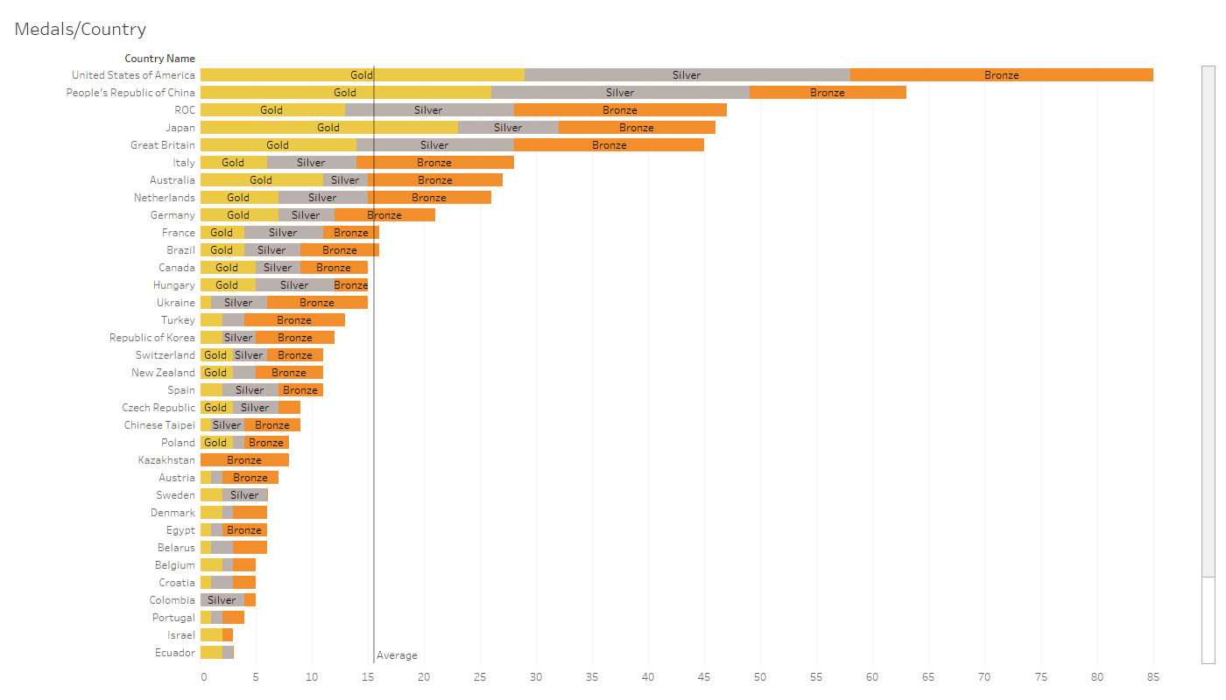
Distribution of Medals per Country

Slide 9
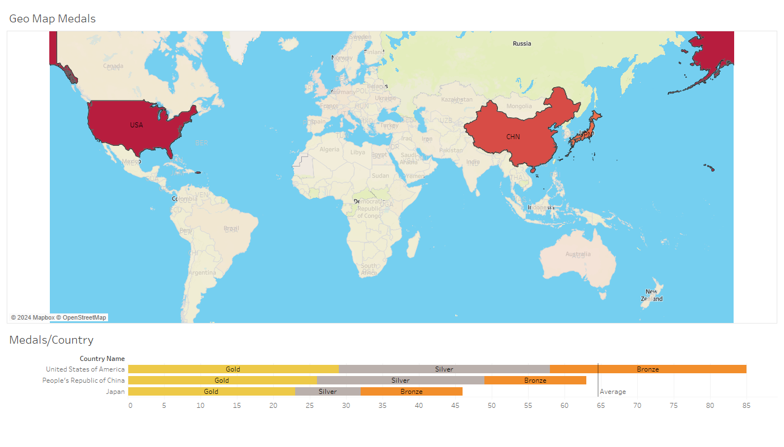
Distribution of Medals per Country

Slide 10
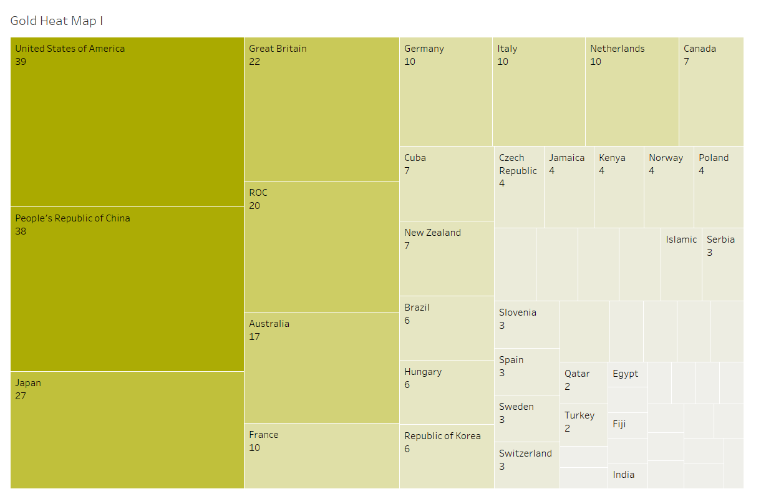
Heatmap - Gold Medals Distribution
Mercury
Venus

Slide 11
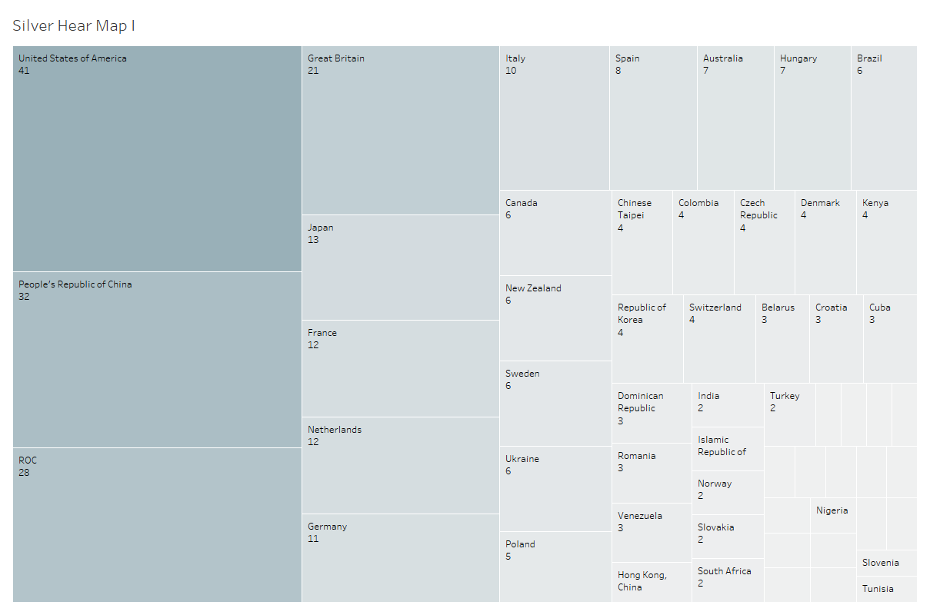
Heatmap - Silver Medals Distribution

Slide 12
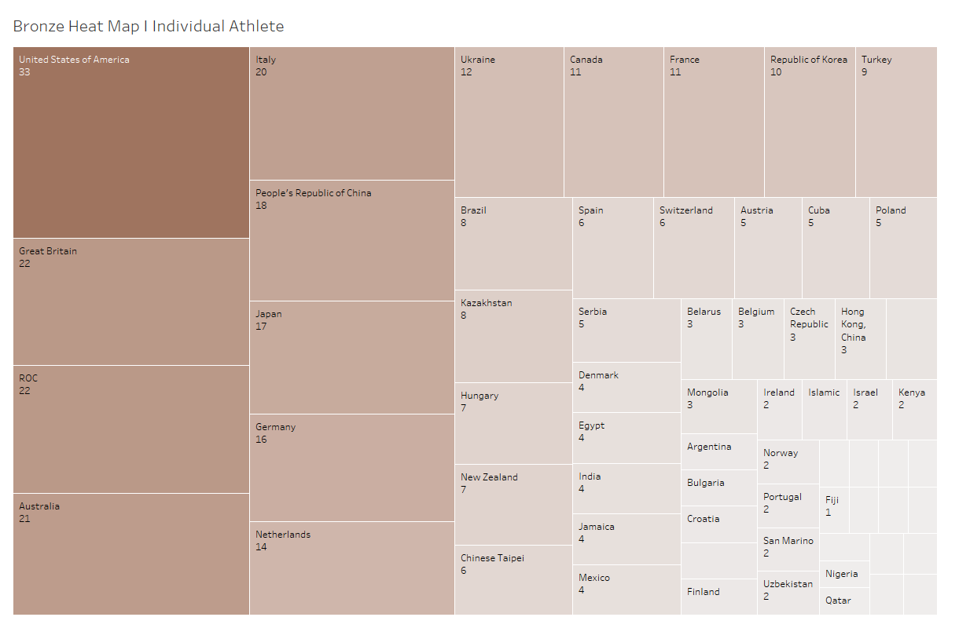
Heatmap - Bronze Medals Distribution

Slide 13
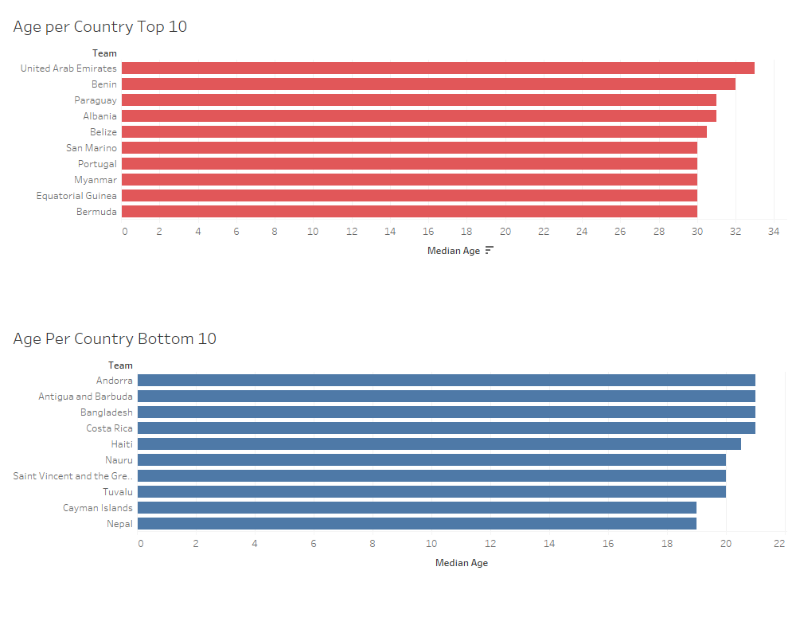
Distribution of Age Per Country

Slide 14
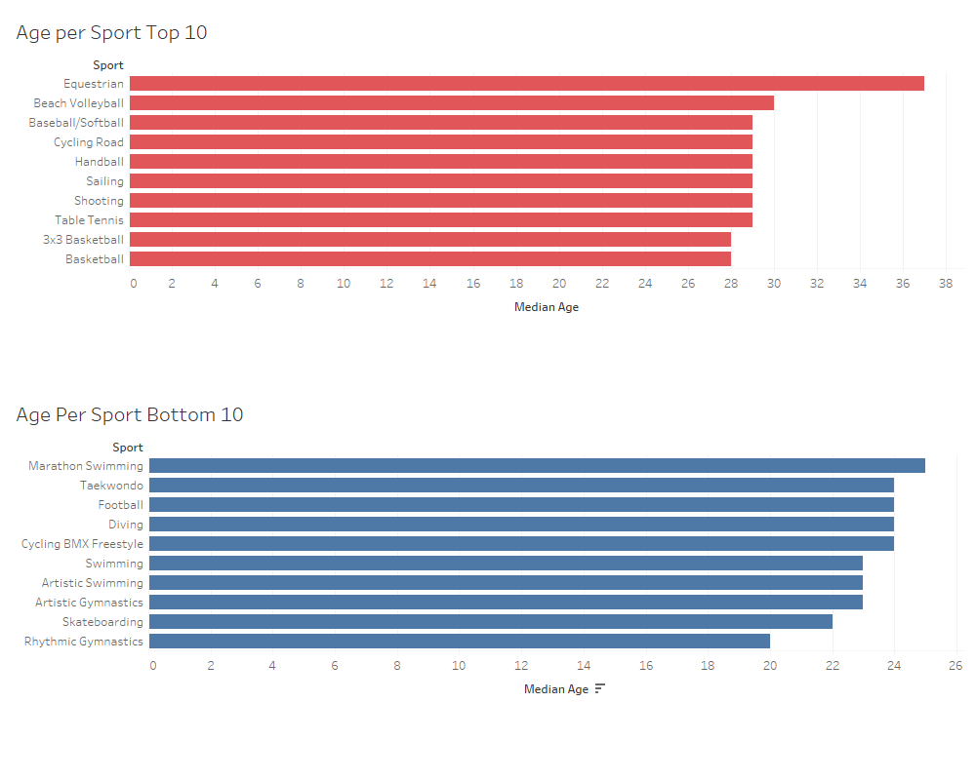
Distribution of Age Per Country

Slide 15
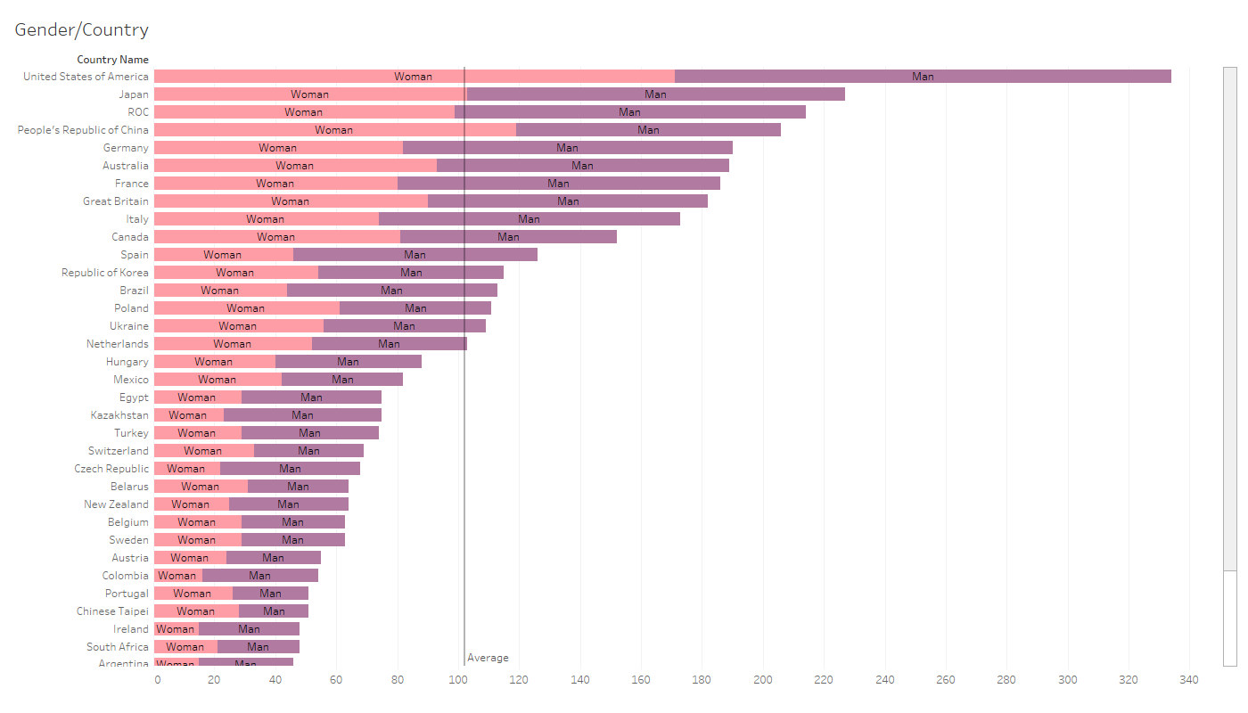
Distribution of Athletes’ Gender per Country
You can replace the image on the screen with your own work. Just right-click on it and select “Replace image”

Slide 16
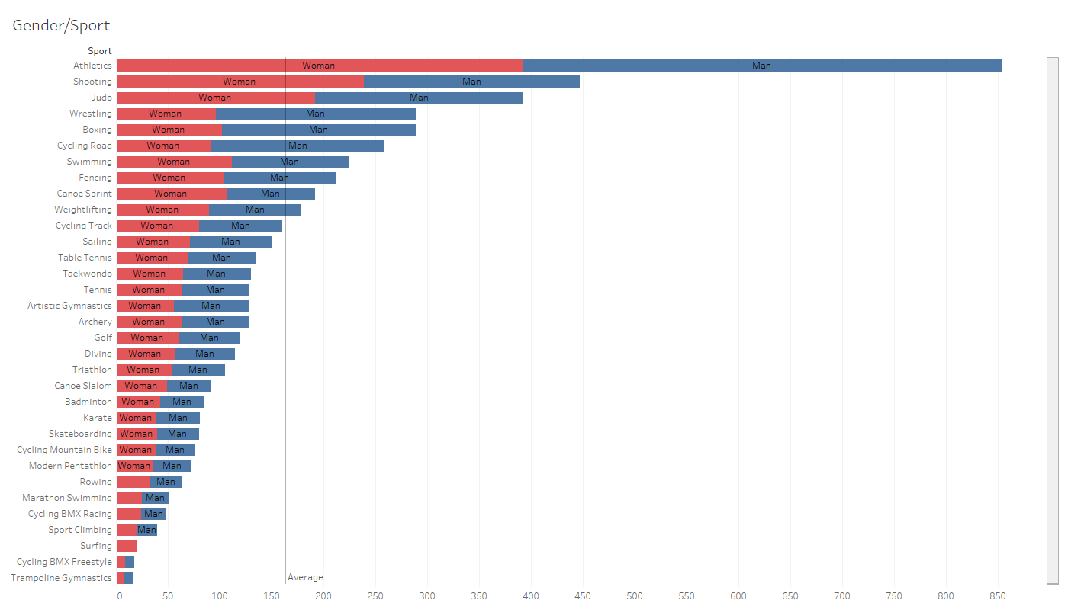
Distribution of Athletes’ Gender per Sport
You can replace the image on the screen with your own work. Just right-click on it and select “Replace image”

Slide 17
Predictive Analysis

Slide 18
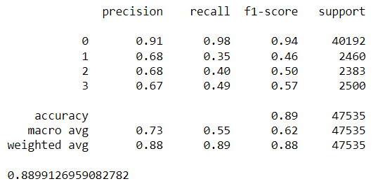
Random Forest Classifier
Accuracy = 88.9%

Slide 19
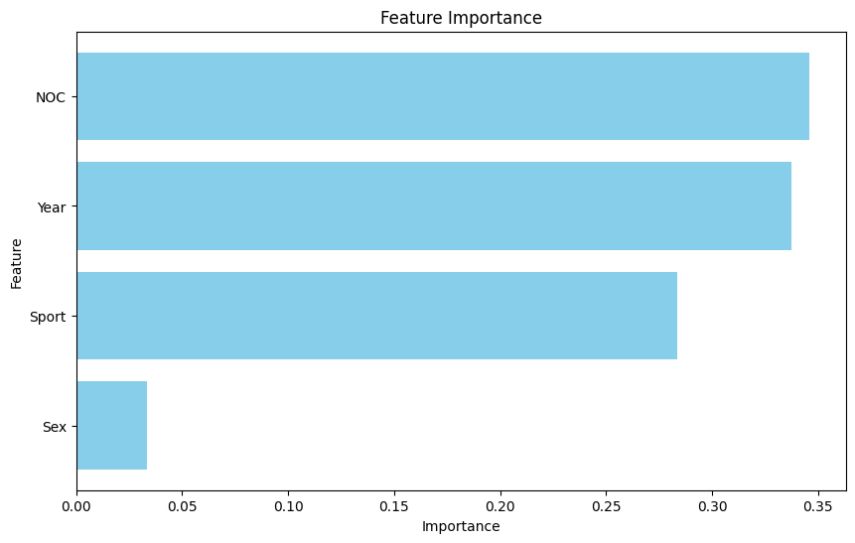
Feature Importance

Slide 20
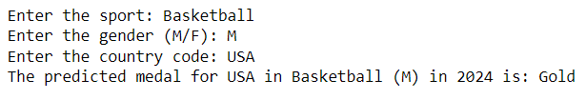
Prediction Function
The function takes sport, gender, and country code inputs from the user and uses the random forest regression model to predict which medal that country will win in 2024 Olympics

Slide 21
Challenges
Faced
This is our first hackathon - figuring out how hackathons work
Ensuring data quality and consistency across different datasets
Interpreting the model output into actionable insights

Slide 22
Future Enhancements
Incorporating real-time data updates closer to the 2024 Olympics
Exploring advanced techniques for more accurate predictions

Slide 23
References
Datasets Used:
https://www.kaggle.com/datasets/surajjha101/countries-olympics-medals-since-1896

Slide 24
Thanks!
Please keep this slide for attribution

